Slide 1
Micro Credit Defaulter Prediction
A Machine Learning Project

Slide 2
Basic background on Micro-Credit
A Microfinance Institution (MFI) is an organization that offers financial services to low income populations
Though, the MFI industry is primarily focusing on low income families and are very useful in such areas, the implementation of MFS has been uneven with both significant challenges and successes.
Today, microfinance is widely accepted as a poverty-reduction tool, representing $70 billion in outstanding loans and a global outreach of 200 million clients.

Slide 3
Problem Statement
Ppredict in terms of a probability for each loan transaction, whether the customer will be paying back the loaned amount within 5 days of insurance of loan. In this case, Label ‘1’ indicates that the loan has been payed i.e. Non- defaulter, while, Label ‘0’ indicates that the loan has not been payed i.e. defaulter.

Slide 4
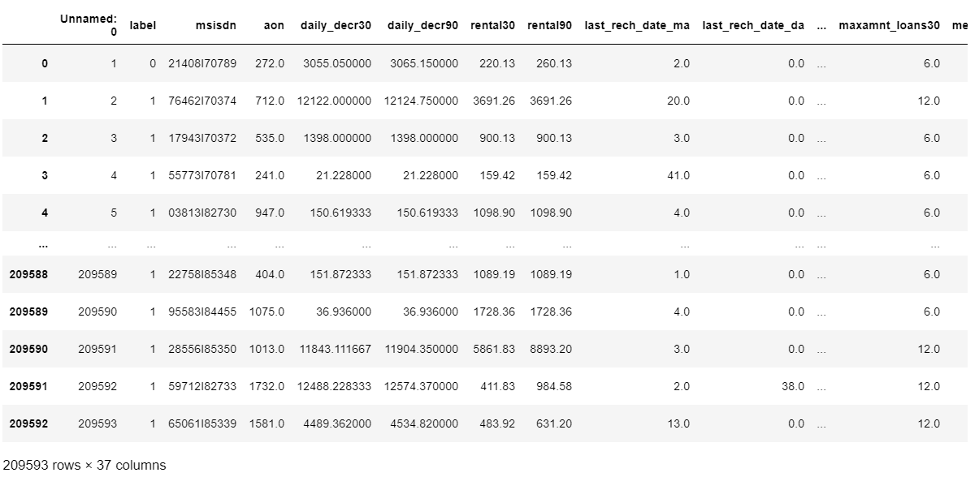
Sample dataset

Slide 5
Data Cleaning
Before creating any model it is necessary to make our data proper .If we feed invalid data then our model will not give good prediction.
Column 1 is just an identifier .So we can drop this column .Also we dropped pdate column as it is not relevant to our test case .
In our dataset there is no NaN value present in data .So no need to treat NaN value in such case
.Msisdn column also an unique presentor of a customer .We can remove this too.
Circle coulmn contains same value across all the row . This will not add any value to our model .So this column can be dropped.
Aon column contains no of days .In real world no of days can not be in negative value.So we dropped those records.
Maxamnt_loans90 and maxamnt_loans30 column contains various type of values.But as per document a user can take only two types of loan.One is of loan amount Rs 5 and other one is of loan amount Rs 10.So max loan amount can be of 0(if no loan),6 or 12(with interest).But if you see the data then you can find data with huge number .We can filter out those data.
There are few columns which contains 0 values more than 90% .In such case we can drop those columns instead of imputing mean value .
Columns'daily_decr90','cnt_loans90','maxamnt_loans90','cnt_loans30','rental90' are highly corelated with other feature.So we can drop these columns.
Then we have removed skewed data and outliers .
After all these process we have standardise the input data as it contains various measures .

Slide 6
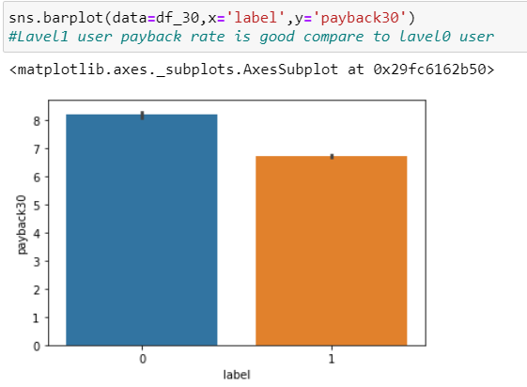
Visualization

Slide 7
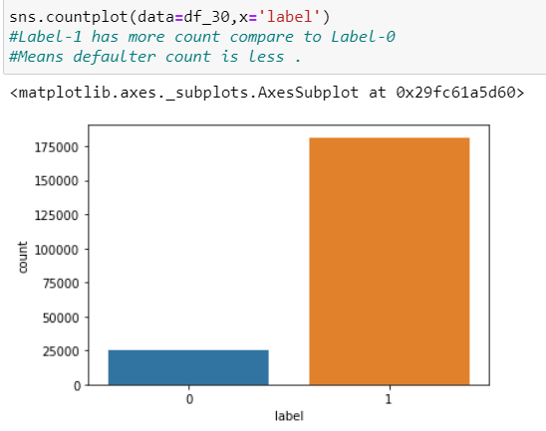
Visualization

Slide 8
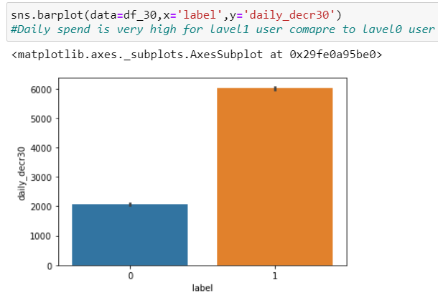
Visualization

Slide 9
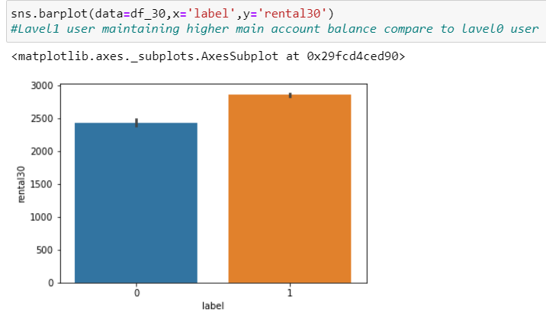
Visualization

Slide 10
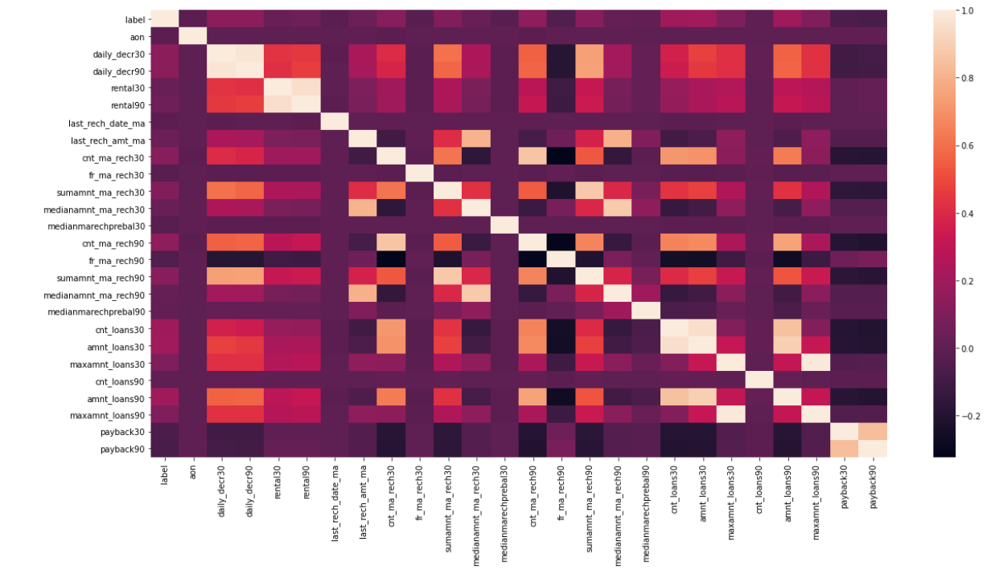
Visualization
daily_decr_30 is highly corelated with daily_decr_90.We can drop any one of the column .
cnt_loans30 is highly corelated with cnt_loans90
maxamnt_loans30 is highly corelated with maxamnt_loans90
amnt_loans30 and amnt_loans90
amnt_loans30 and cnt_loan30
rental30 and rental90

Slide 11
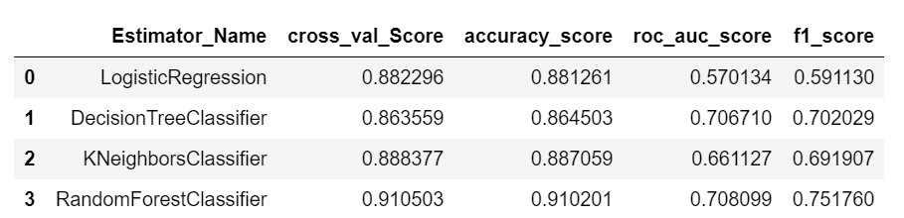
Model Selection
This is a classification problem.
Here we have used four classification algorithm below .
LogisticRegression
DecisionTreeClassifier
KNeighborsClassifier
RandomForestClassifier
From above all model RandomForestClassifier model works better as per below matrix

Slide 12
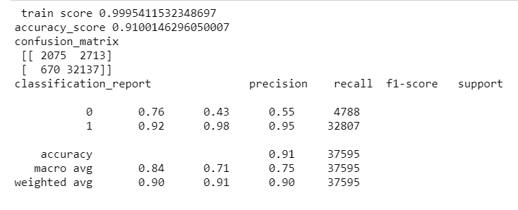
Hyper parameter tuning for better performance
From previous slide we conclude that RandomForest model is working better than rest of the model.
Now to improve the score of randomforest model lets tune it’s hyperparameter.
I have choose criterion as gini and n_estimators as 300 .
Printing final model’s classification report .

Slide 13

Thank You

